Slide 1
Z Transforms
Lecture 35 - 36

Slide 2
LTI systems
Impulse response h[n]
LTI
F

Slide 3
LTI systems
Impulse response h[n]
LTI

Slide 4
LTI systems
Impulse response h[n]
LTI

Slide 5
LTI systems
Impulse response h[n]
LTI

Slide 6
LTI systems
Impulse response h[n]
LTI

Slide 7
LTI systems
Impulse response h[n]
LTI

Slide 8
LTI systems
Impulse response h[n]
LTI

Slide 9
Applications of Z transforms
Scale transformations (images with different resolutions)
Solving Difference equations with initial conditions

Slide 10
Z-Transform
Bilateral
Z

Slide 11
Connection between Z and Fourier Transform
Z may converge when F does not

Slide 12
Causal Exponential Function
Find the z-transform of
X(z) exists outside a circle with radius |a|.

Slide 13
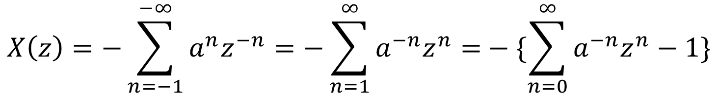

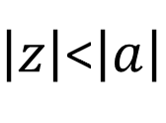
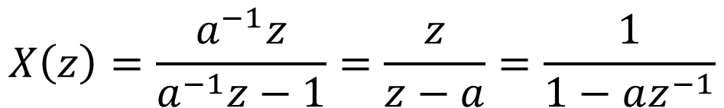
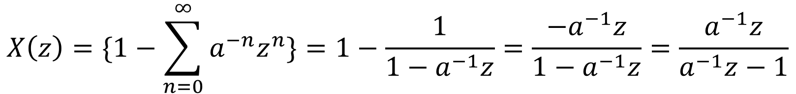
Anticausal Exponential Function
Find the z-transform of
$$x\left[n\right]=−a^{n}u[−n−1]$$
$$X\left(z\right)=−\sum_{n=−1}^{−∞}{a^{n}z^{−n}=−\sum_{n=1}^{∞}{a^{−n}z^{n}=}}−\{\sum_{n=0}^{∞}{a^{−n}z^{n}−1\}}$$
$$X\left(z\right)=\{1−\sum_{n=0}^{∞}{a^{−n}z^{n}\}=1−\frac{1}{1−a^{−1}z}=\frac{−a^{−1}z}{1−a^{−1}z}=\frac{a^{−1}z}{a^{−1}z−1}}$$
$$X\left(z\right)=\frac{a^{−1}z}{a^{−1}z−1}=\frac{z}{z−a}=\frac{1}{1−az^{−1}}$$
$\left|z\right|$<$\left|a\right|$

Slide 14
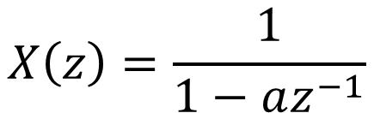


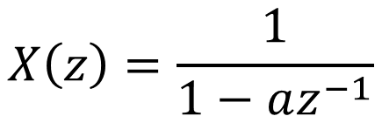

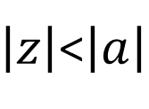
Exponential Function
Z-transform of
$$X\left(z\right)=\frac{1}{1−az^{−1}}$$
$$x\left[n\right]=−a^{n}u[−n−1]$$
$\left|z\right|$<$\left|a\right|$
$$x\left[n\right]=a^{n}u[n]$$
$$X\left(z\right)=\frac{1}{1−az^{−1}}$$
$$\left|z\right|>\left|a\right|$$

Slide 15
Two-Sided Exponential Function
X(z) exists within the ring

Slide 16
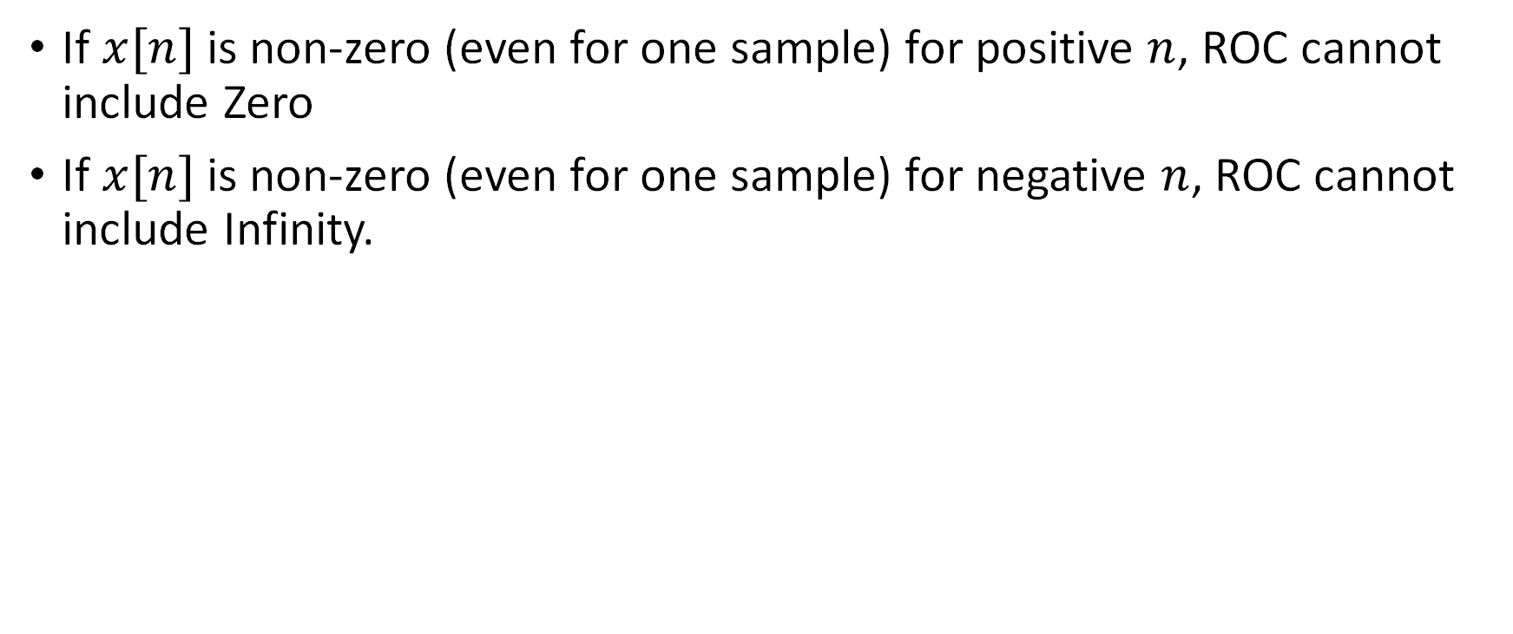
Annoying points in ROC
If $x[n]$is non-zero (even for one sample) for positive $n$, ROC cannot include Zero
If $x[n]$is non-zero (even for one sample) for negative $n$, ROC cannot include Infinity.

Slide 17
ROC Summary
The ROC of a causal function is outside the circle bordering the outermost pole (Fig. a).
The ROC of an anticausal function is inside the circle bordering the innermost pole (Fig b).
The ROC of a two-sided function is an annular ring containing no poles (Fig. c).

Slide 18
ROC Summary
The ROC of a right-sided non-causal function is outside the circle bordering the outermost pole, except at z = Infinity
The ROC of a left sided non-anticausal function is inside the circle bordering the innermost pole, except at z = 0

Slide 19
Causal and Stable Discrete-time LTI system
Choose the right option
I) All poles lie in right-half plane
II) All poles lie in left-half plane
III) All poles lie inside r=1 circle
IV) All poles lie outside r=1 circle

Slide 20
Causal and Stable LTI system
Choose the right option
I) All poles lie in right-half plane
II) All poles lie in left-half plane
III) All poles lie inside r=1 circle
IV) All poles lie outside r=1 circle

Slide 21
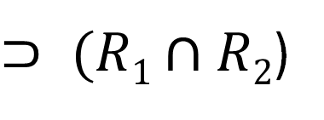
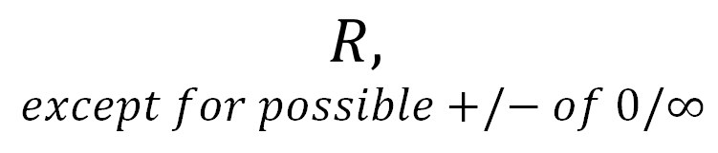
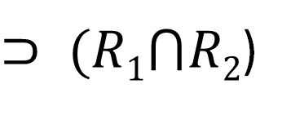
Properties of Z Transforms
Linearity
Time-shift
Convolution
$⊃ (R1⋂R2$)
$$R,$$
$$except for possible+/− of 0/∞$$
$⊃ (R1∩R2$)

Slide 22


Properties of Z Transforms
Modulation
Differentiation in z domain
$$R\left|z_{o}\right|$$
$$R$$

Slide 23
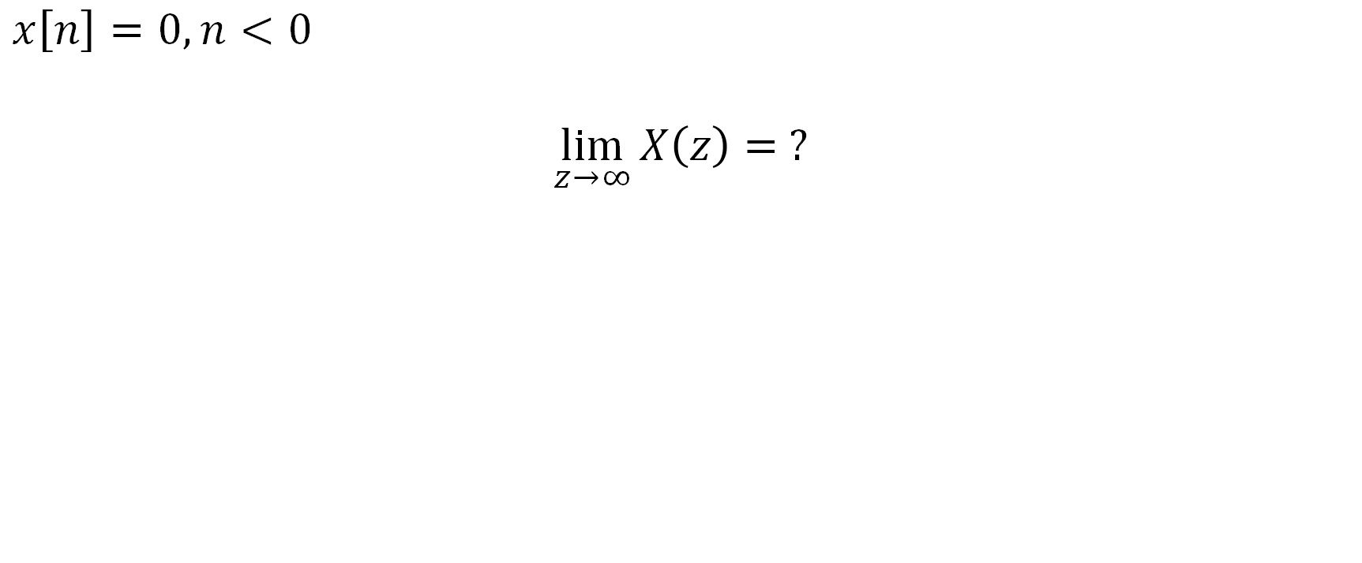
Check yourself:
$$x\left[n\right]=0, n<0$$
$$\lim_{z→∞}{X\left(z\right)}= ?$$

Slide 24
Check yourself:
$$x\left[n\right]=0, n<0$$
$$\lim_{z→∞}{X\left(z\right)}= ?$$

Slide 25
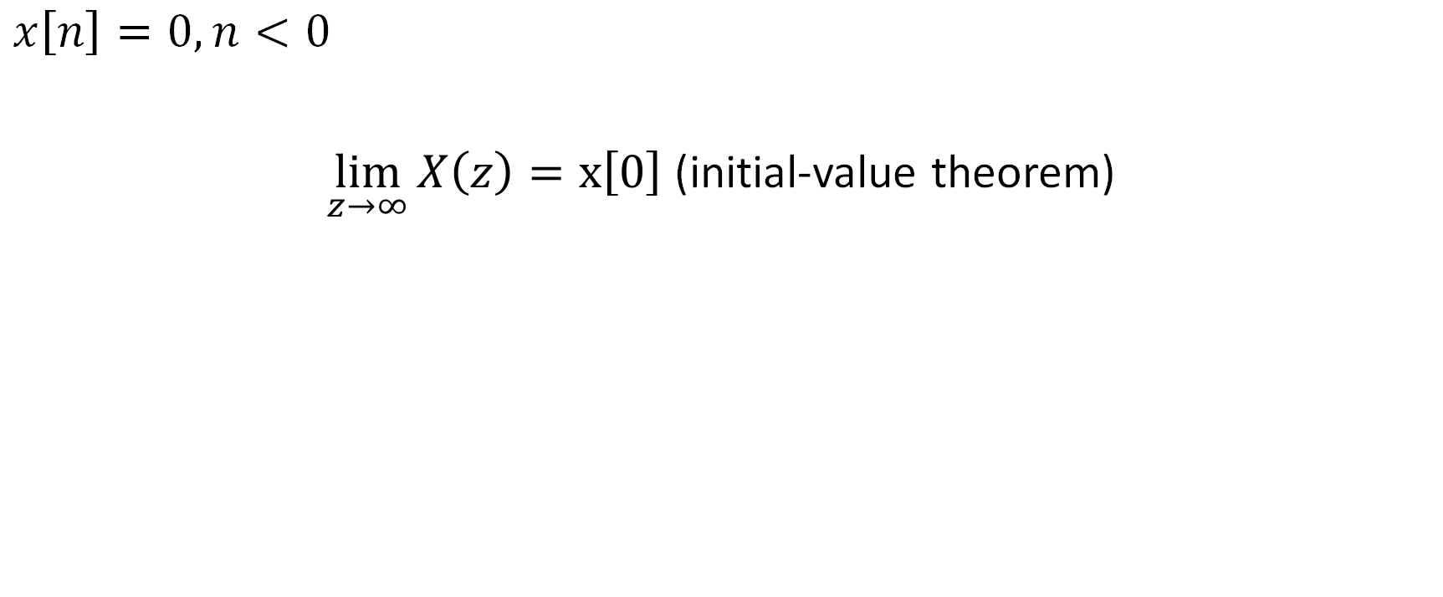
Check yourself:
$$x\left[n\right]=0, n<0$$
$\lim_{z→∞}{X\left(z\right)}=x\left[0\right]$ (initial-value theorem)
If x[0] is finite, then the number of zeros cannot be greater than the number of poles

Slide 26
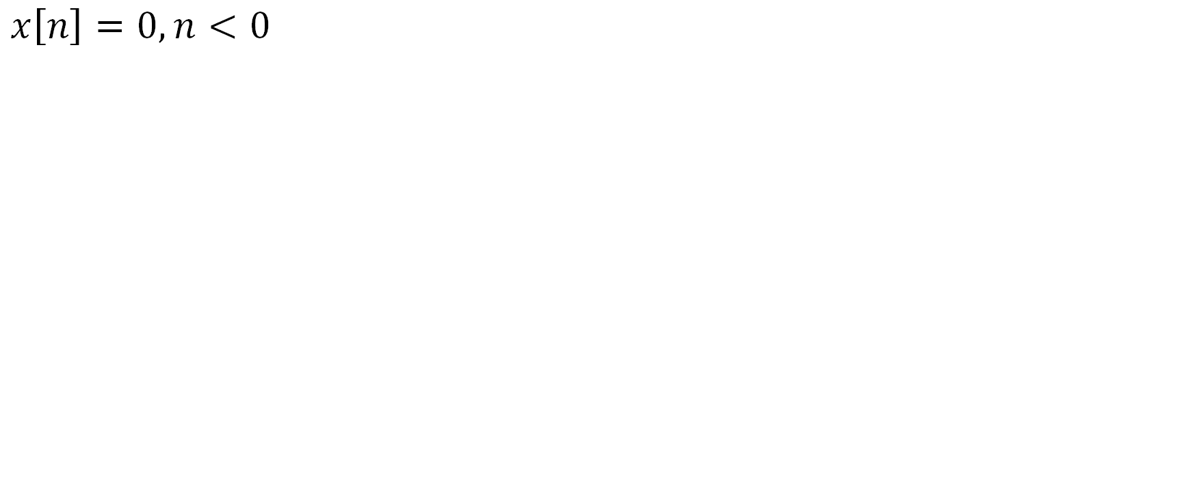
Check yourself:
$$x\left[n\right]=0, n<0$$

Slide 27
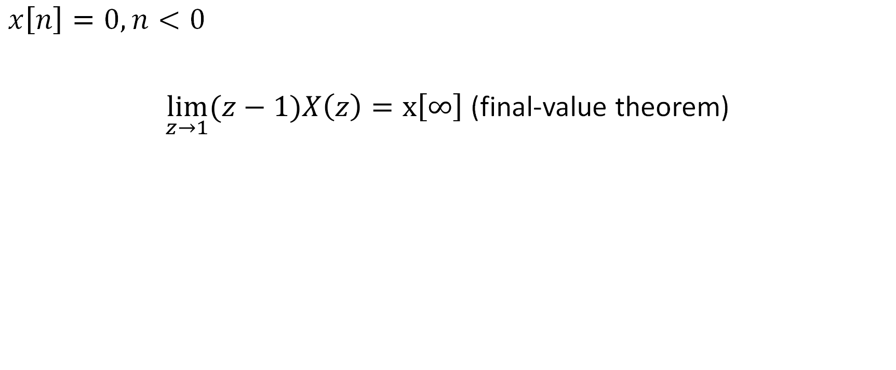
Check yourself:
$$x\left[n\right]=0, n<0$$
$\lim_{z→1}{(z−1)X\left(z\right)}=x\left[∞\right]$ (final-value theorem)
x[∞] is finite, and the order of poles at z = 1 is not more than 1.

Slide 28
Check yourself
Find x[n]

Slide 29
Example of Inverse by Expansion
Find inverse z-transform of

Slide 30
Example of Inverse by Expansion
Find inverse z-transform of
Solution. We first reduce the degree of the numerator by extracting the constant -2 from it, then expand into fractions

Slide 31
Application to Difference Equations
Consider the difference equation (with x(n) known for all n)
Taking the bilateral z-transform of both sides and making use of shift property, we find
Let
Then

Slide 32
Filter (what kind of filter is this?)
Which filter?
i) All-pass
ii) Band-pass
iii) Low-pass
iv) High-pass

Slide 33
Filter (where are the poles?)

Slide 34
Filter

Slide 35
Changing r = 0.9

Slide 36
Changing r = 0.8

Slide 37
Changing r = 0.6

Slide 38
Changing r = 0.4

Slide 39
Changing r = 0.2

Slide 40
Changing theta = 150

Slide 41
Changing theta = 135

Slide 42
Changing theta = 120

Slide 43
Changing theta = 90

Slide 44
Changing theta = 0

Slide 45
Changing theta = 180

Slide 46
Unilateral Z transform

Slide 47
Unilateral Z transform

Slide 48
Unilateral Z transform

Slide 49
Unilateral Z transform

Slide 50
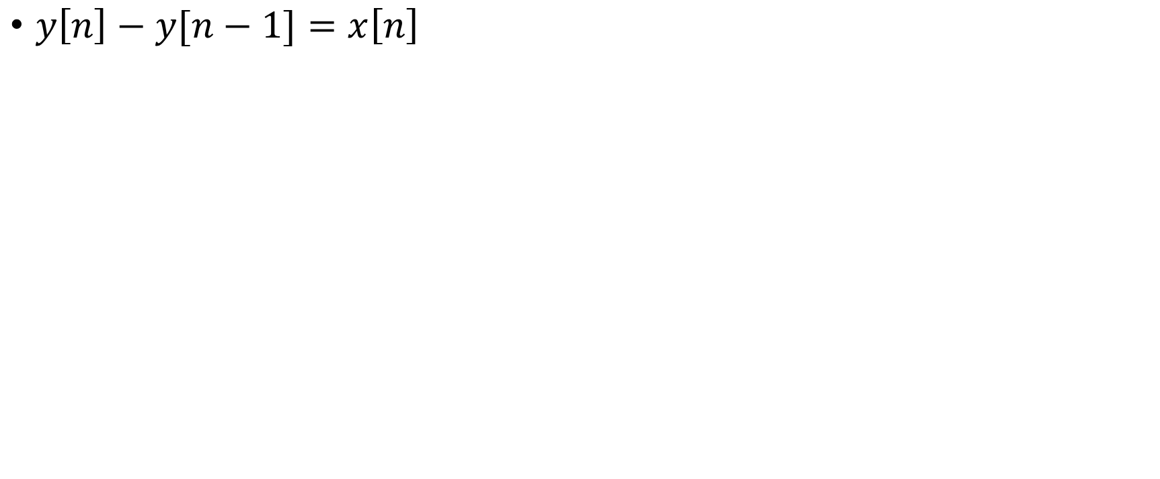
Solving DE with initial conditions
$y\left[n\right]−y[n−1]=x\left[n\right]$

Slide 51
Solving DE with initial conditions
$y\left[n\right]−y[n−1]=x\left[n\right]$

Slide 52
Solving DE with initial conditions
$y\left[n\right]−y[n−1]=x\left[n\right]$

Slide 53
Solving DE with initial conditions

